Slide 1
LOCATION
RECONSTRUCTION OF GREEN ROAD STAFF QUARTER
Group 2
Reconstruction of Green Road Staff Quarter
1

Slide 2
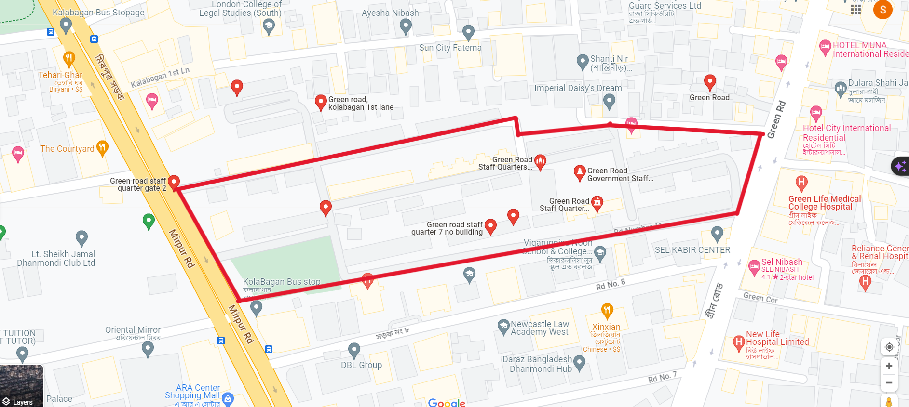
LOCATION
Green Road, Dhanmondi, Dhaka-1205
Google Map- 23°44'46.6"N 90°22'59.2"E
Group 2
Reconstruction of Green Road Staff Quarter
2

Slide 3
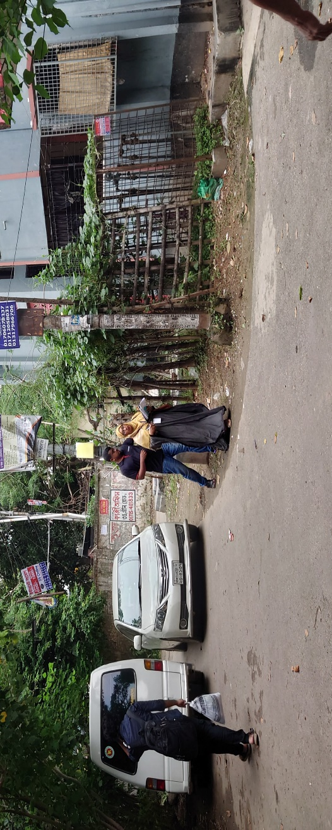
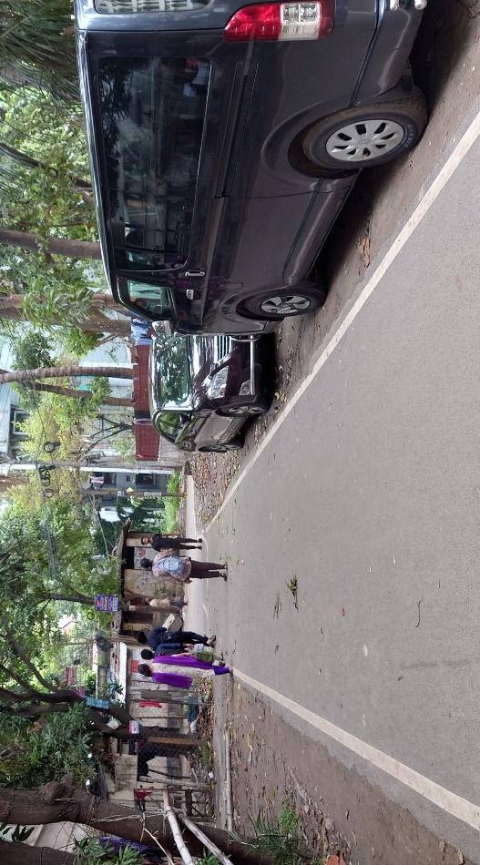

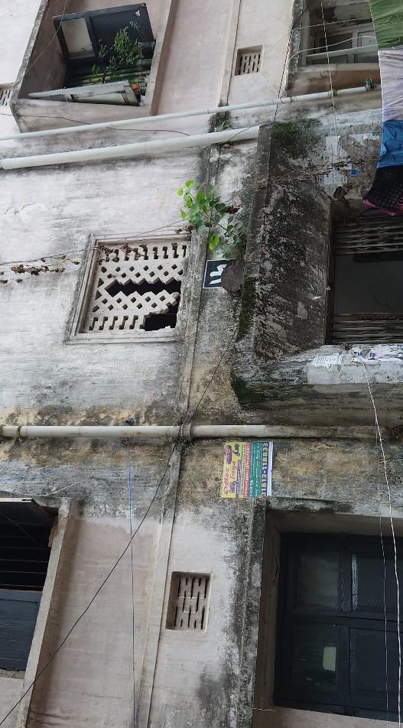
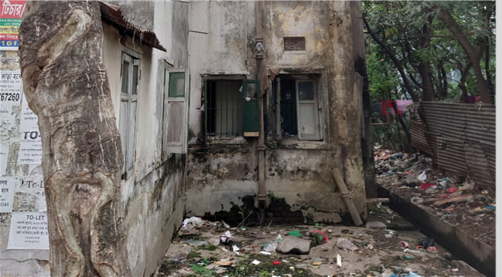
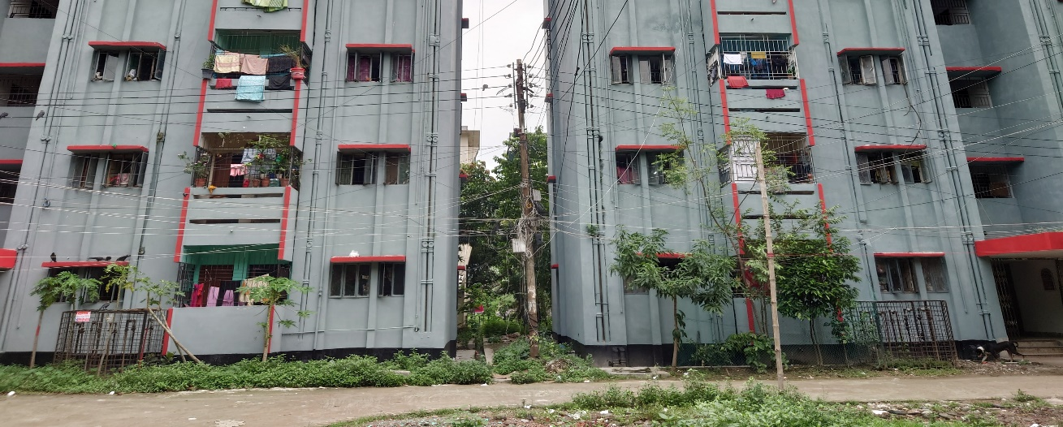
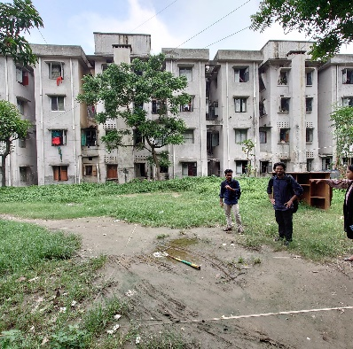
CURRENT SCENARIO
No dedicated parking facility
Most of the buildings are old and fragile
Buildings are closely placed

Slide 4
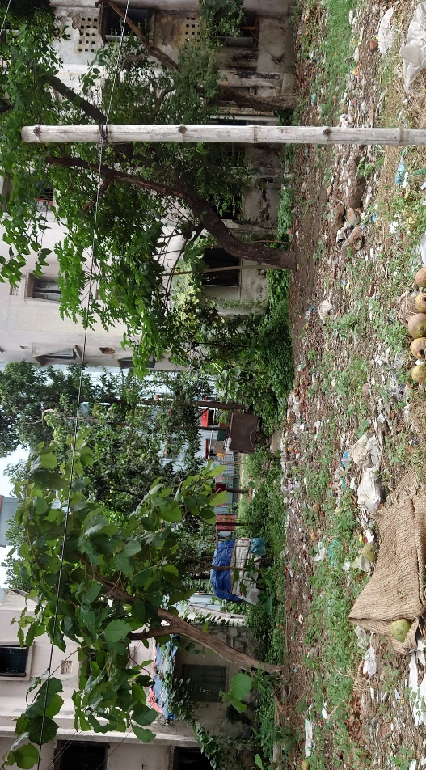
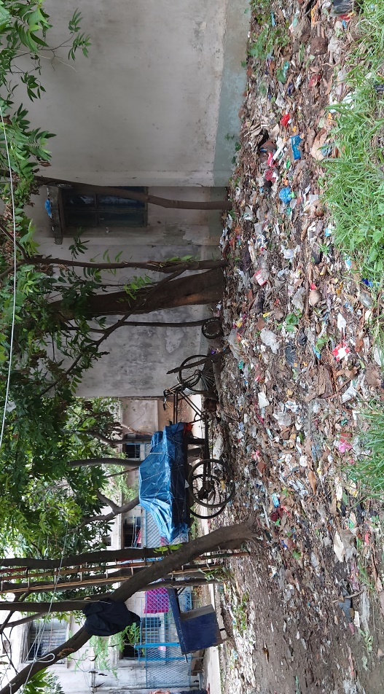
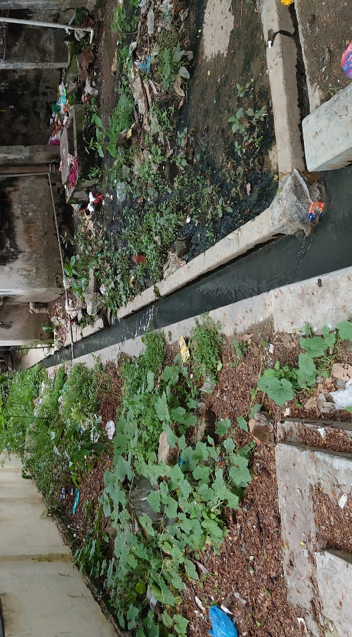
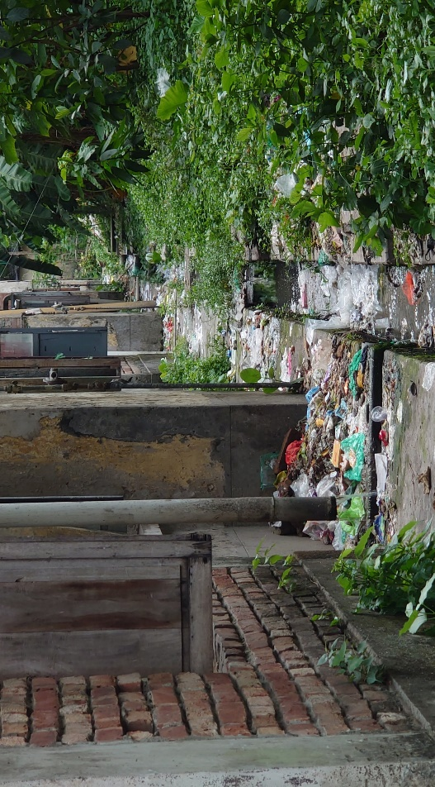
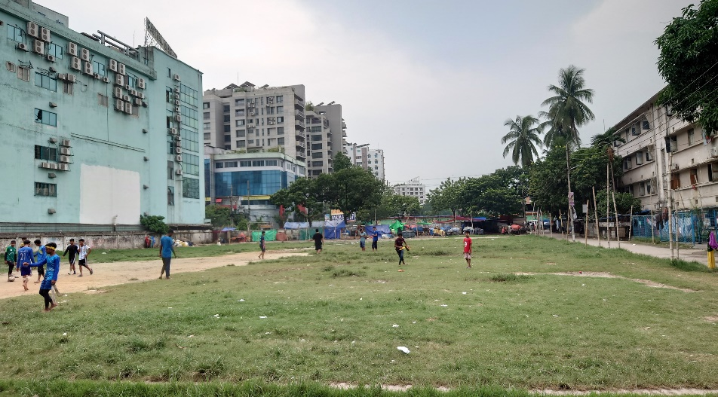
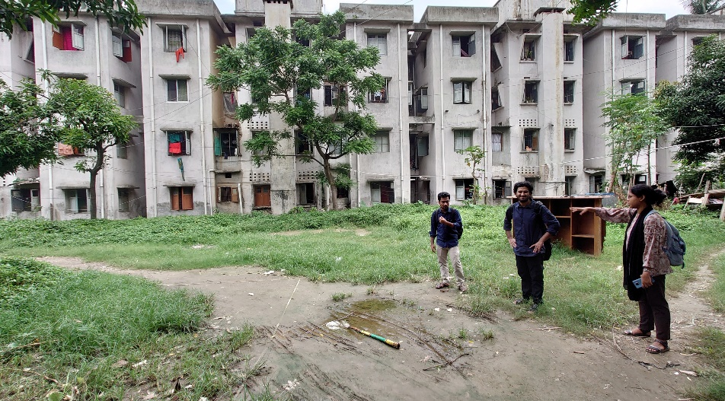
No proper waste management system
Unhygienic and poor drainage situation
Poor condition of the sports arenas

Slide 5






CURRENT SCENARIO
27 Buildings
0 pond
Project area 0.5 km²
2 Sport Field
500 Family
1 Mosque
Group 2
Reconstruction of Green Road Staff Quarter
5

Slide 6





STAKEHOLDERS
Government Officials (PWD)
Representatives from Green Life Hospital and Modern Hospital
People Living Near the Project
Current Residencies
Shop Owners Near the Project
Group 2
Reconstruction of Green Road Staff Quarter
6

Slide 7
STAKEHOLDER SURVEY
Unsatisfactory
Neutral
Satisfactory
Current Residential Facilities of the Quarter is Satisfactory or Not
Waste Management System of the Area
Necessity for the Inclusion of Sports Field and Playground within the Facility
Condition and Safety of Internal Roadway System
Condition and Positioning of Existing Buildings
Parking Facilities inside the Staff Quarter
Group 2
Reconstruction of Green Road Staff Quarter
7

Slide 8

PROJECT OBJECTIVE
Enhance green spaces and landscaping for a healthier environment.
Optimize space utilization through taller, consolidated structures.
Upgrade plumbing infrastructure for proper water management.
Implement efficient waste management systems.
OBJECTIVES
Enhance overall living conditions and hygiene standards.
Improve parking infrastructure and accessibility.
Renovate sports arenas for community use and enjoyment.
Group 2
Reconstruction of Green Road Staff Quarter
8

Slide 9
SPECIFIC GOALS
2
HIGH RISE BUILDING
1
MASTER PLAN
MODELING
13 STORIED BUILDING
(WITH BASEMENT)
4 UNIT APARTMENT (DIFFERENT SIZE)
DEDICATED PARKING FACILITY
PROPER ORIENTATION OF BUILDING
OPEN AND GREEN SPACE AREA
Group 2
Reconstruction of Green Road Staff Quarter
9

Slide 10





ACTIVITY OUTLINE
STEP
STEP
STEP
STEP
STEP
01
02
03
04
05
Data Collection
Preliminary
Design
Evaluation of Alternative Analysis
EIA
Financial & Economic Analysis
PWD Office
WASA
City corporation
Survey
Soil Report
Draft Master Plan
Draft Floor Plan
Components Size
Preliminary Cost Analysis for Alternatives
Alternative Design Analysis
Group 2
Reconstruction of Green Road Staff Quarter
10

Slide 11





ACTIVITY OUTLINE
STEP
STEP
STEP
STEP
STEP
06
07
08
09
10
Detail Design & Analysis
Bill of Quantity
Construction
& Quality
Control
Opening &
Operation
Tendering
ETABS Modeling
RCC Design
Water Reservoir & Septic Tank Design
Plumbing and Drainage
Group 2
Reconstruction of Green Road Staff Quarter
11

Slide 12
SURVEY AND DATA
Traffic Data Collection and Analysis
Group 2
Reconstruction of Green Road Staff Quarter
12

Slide 13
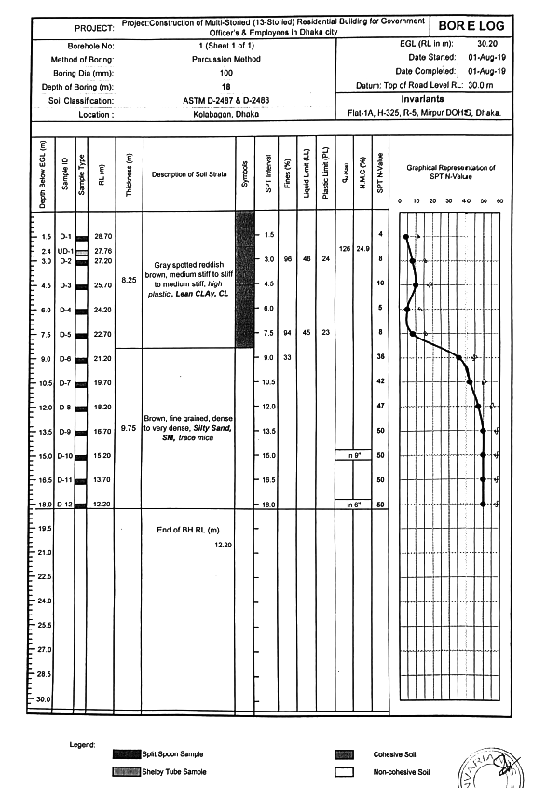
SURVEY AND DATA
Soil Test Report Collection, Summarizing and Analysis
0 meter
Stiff Clay
9 meter
Dense Sand
18 meter
Group 2
Reconstruction of Green Road Staff Quarter
13

Slide 14
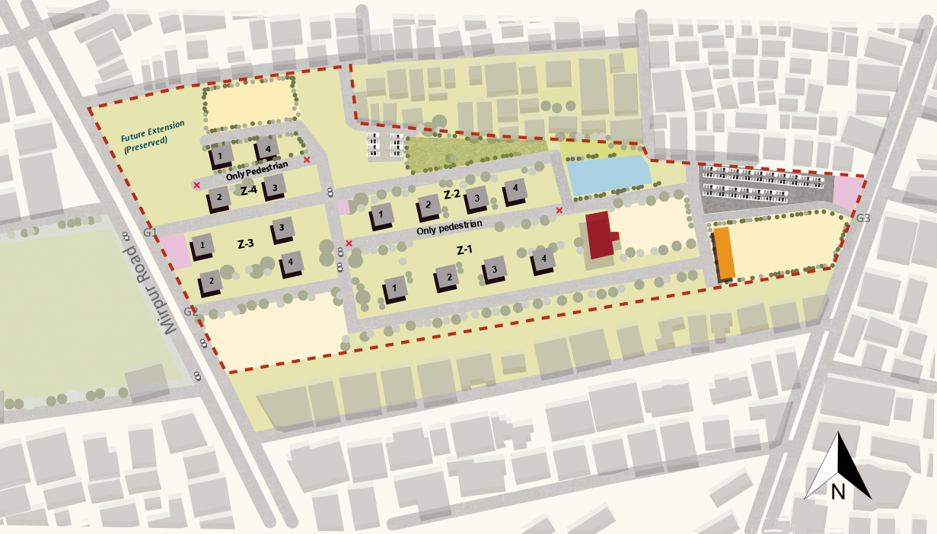

MASTER PLAN
Group 2
Reconstruction of Green Road Staff Quarter
14

Slide 15
MASTER PLAN
Residential Buildings
Outside Parking
Playground
Garden
Pond
Mosque
Total plan area = 5,43,660 sft
Four Different Zones
z-1 -> 1500 sft
z-2 -> 1200 sft
z-3 -> 1000 sft
z-4 -> 800 sft
Building to building distance = 70ft
Mosque floor area = 5166 sft
Community Centre floor area = 6835 sft
Field
Community Centre
Outside Parking
Group 2
Reconstruction of Green Road Staff Quarter
15

Slide 16

ENVIRONMENTAL IMPACT ASSESSMENT
“RED” category project => EIA required
Baseline environment: Physicochemical
Baseline environment: Physicochemical
20%
Baseline Environment : Physicochemical
Baseline Environment study
Baseline environment: Ecological environment
40%
Baseline environment: Socio-economic environment
60%
Group 2
Reconstruction of Green Road Staff Quarter
16

Slide 17
PRE-CONSTRUCTION STAGE
ENVIRONMENTAL IMPACT AND MITIGATION MEASURE
ENVIRONMENTAL IMPACTS
MITIGATION MEASURES
SOLID WASTE
PROPER SOLID WASTE MANAGEMENT
UNDERGROUND GAS PIPELINE
SHIFTING THE GAS LINES
CUTTING OF TREES
TREE PLANTATION AFTER CONSTRUCTION
Group 2
Reconstruction of Green Road Staff Quarter
17

Slide 18
CONSTRUCTION STAGE
ENVIRONMENTAL IMPACT AND MITIGATION MEASURE
ENVIRONMENTAL IMPACTS
MITIGATION MEASURES
AIR AND SOUND POLLUTION
EMISSION CONTROL DEVICE AND NOISE CONTROL KITS
BLOCKAGE TO DRAINAGE
ENSURE 3R (REDUCE, REUSE, RECYCLE)
TRAFFIC CONGESTION
DELIVERY OF MATERIALS AT OFF PEAK HOUR
IMPROPER MANAGEMENT OF
SEWAGE WASTE
PROPER SANITATION AND OTHER FACILITIES
Group 2
Reconstruction of Green Road Staff Quarter
18

Slide 19
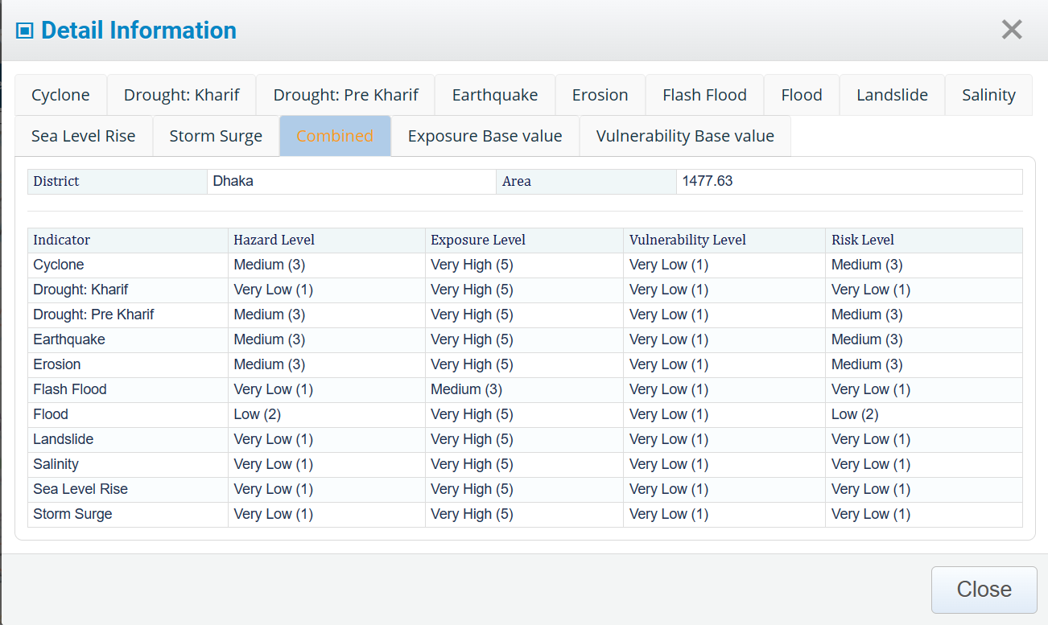
RESETTLEMENT AND DISASTER RESILIENCE
Resettlement Issue
Disaster Resilience of the Project Site
Will be given money for relocation
Legal consideration from government
Transportation facilities or corresponding money
Disaster Risk Reduction measures
Elevation of the area
High strength steel and concrete will be used
Bare land will be surrounded with greeneries
Group 2
Reconstruction of Green Road Staff Quarter
19

Slide 20
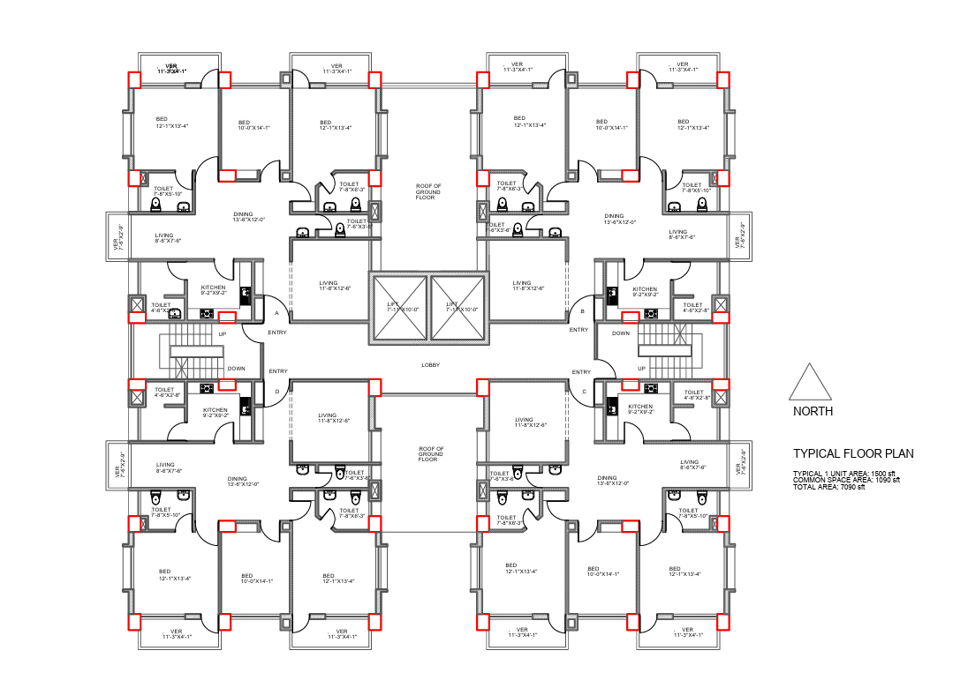
Typical Floor Plan
TYPICAL FLOOR PLAN
Typical Floor Plan Details:
Total Area = 7090 sft
Common Space Area= 1090 sft
Number of Apartment = 4
For each apartment :
• 3 Bedrooms
Room 1 : 12’-1”X13’-4”
Room 2: 10’-0”X14’-7”
Room 3: 12’-1”X13’-4”
• 4 Toilets
• 1 Dining Room : 13’-6”X12’-0”
• 2 Living Rooms
• 1 Kitchen : 9’-2” X9'-2”
• 3 Verandas
Number of stair in building = 2
Number of lifts in building = 2
Size of lift : 7’-11”X10’-0”
Group 2
Reconstruction of Green Road Staff Quarter
20

Slide 21
ANALYSIS OF ALTERNATIVES
TYPE A
TYPE B
Beam supported slab
Mat foundation
.
Flat Plate
Pile Foundation
Alternatives | Cost |  | Design |  | Material Availability |  | Aesthetic |  | Qualitative Comparison |  | Total
 | Weightage | Score | Weightage | Score | Weightage | Score | Weightage | Score | Weightage | Score
Type A | 0.3 | 80 | 0.2 | 80 | 0.15 | 80 | 0.2 | 70 | 0.15 | 80 | 78
Type B | 0.3 | 60 | 0.2 | 70 | 0.15 | 80 | 0.2 | 80 | 0.15 | 90 | 73.5
Group 2
Reconstruction of Green Road Staff Quarter
21

Slide 22
4
DESIGN BASIS
EXPOSURE
CATEGORY
SEISMIC ZONE
ZONE-02 (DHAKA)
ZONE COEFFICIENT=0.20
1
CATEGORY-A (URBAN AREA)
2
OCCUPANCY CATEGORY
BUILDING TYPE
3
4
FLEXIBLE (T>1S)
OC-02
(RESIDENTIAL)
IMPORTANCE FACTOR=1.0
Group 2
Reconstruction of Green Road Staff Quarter
22

Slide 23
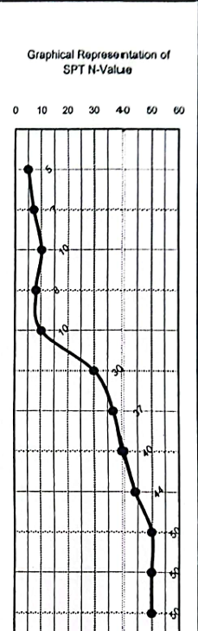
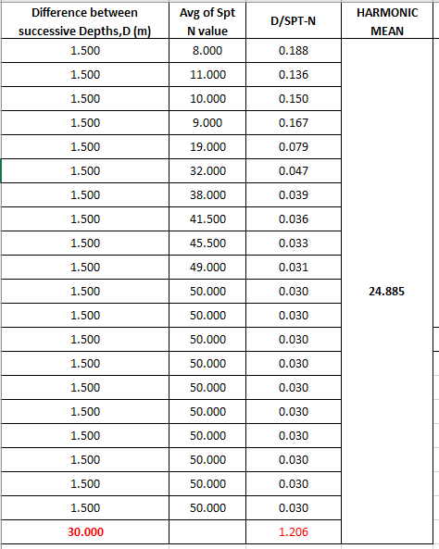
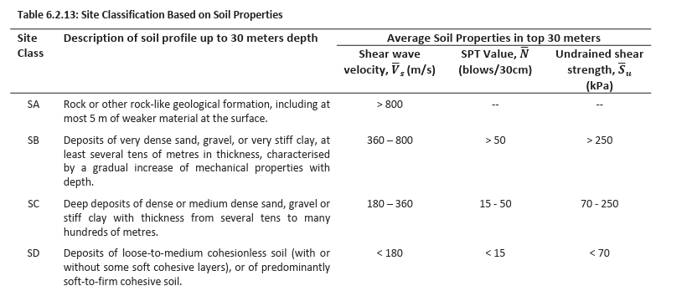
DESIGN BASIS
SITE CLASS
SC
Group 2
Reconstruction of Green Road Staff Quarter
23

Slide 24
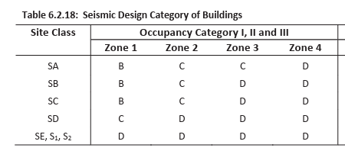
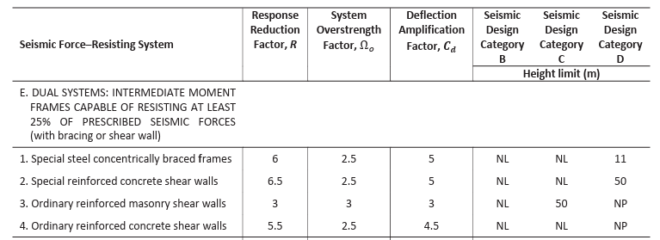
DESIGN BASIS
SEISMIC DESIGN CATEGORY
SEISMIC FORCE RESISTING SYSTEM
SDC-C
IMRF+SHEAR WALL
Group 2
Reconstruction of Green Road Staff Quarter
24

Slide 25
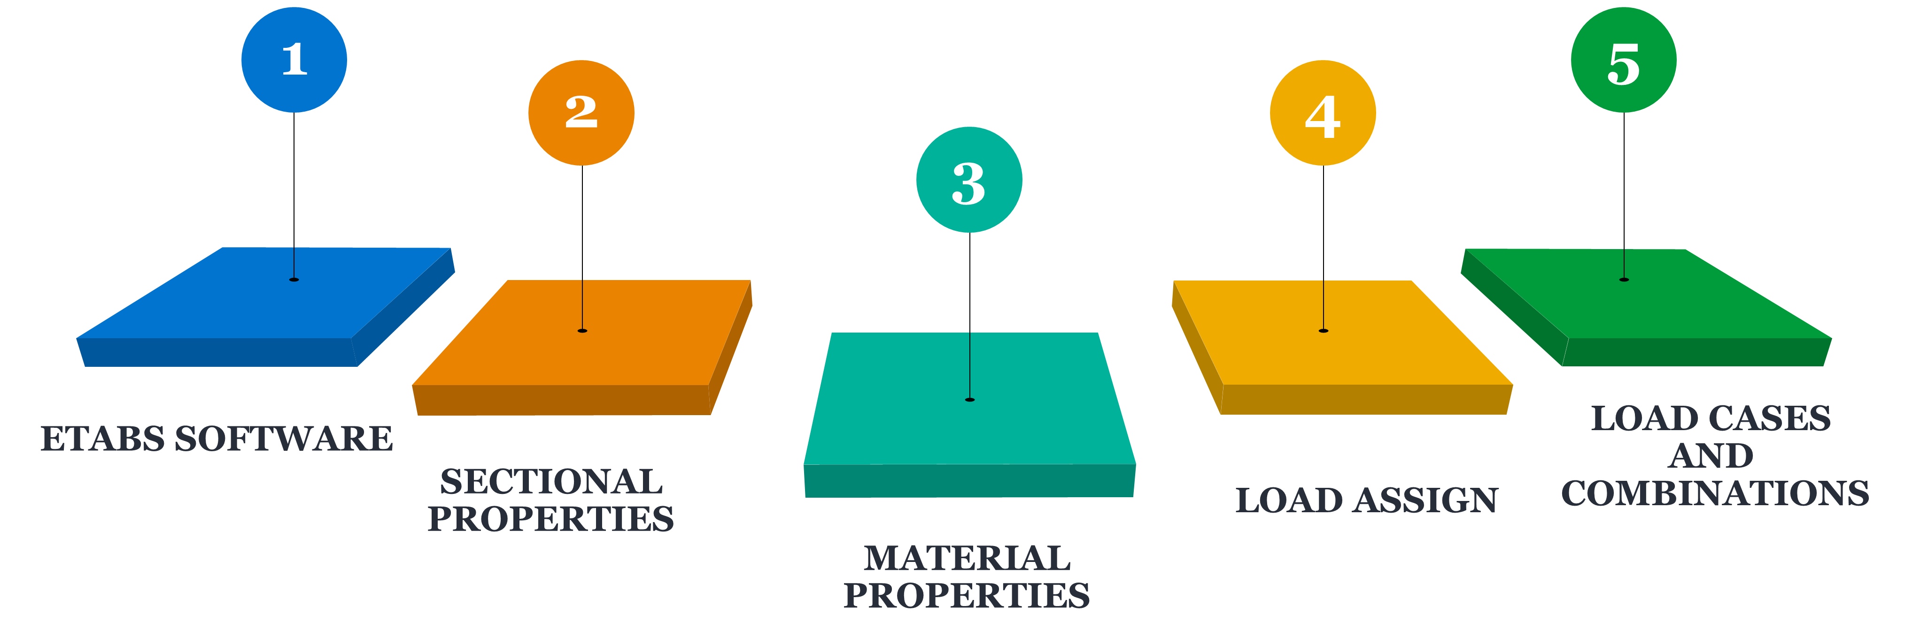
MODELING PARAMETERS
Group 2
Reconstruction of Green Road Staff Quarter
25

Slide 26
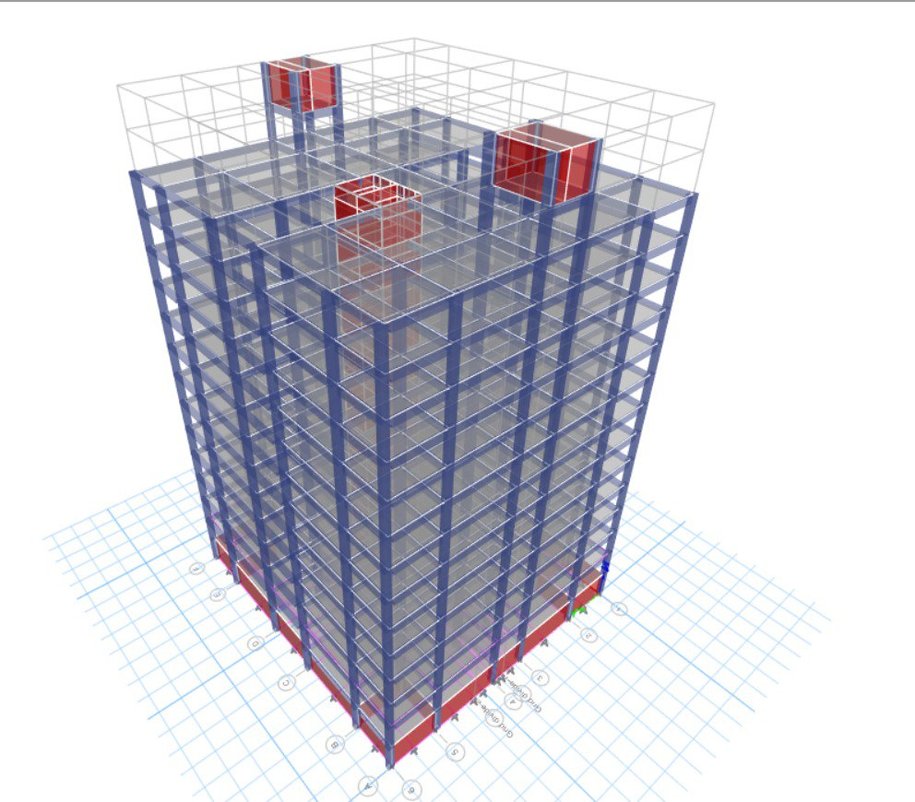
MODEL FOR ANALYSIS
Group 2
Reconstruction of Green Road Staff Quarter
26

Slide 27
SERVICEABILITY ANALYSIS
1
BEAM DEFLECTION
(SHORT TERM AND LONG TERM)
2
WIND SWAY
3
WIND DRIFT
4
EQ DRIFT
5
TORSIONAL IRREGULARITY
6
SLAB DEFLECTION
(SHORT TERM AND LONG TERM)
Group 2
Reconstruction of Green Road Staff Quarter
27

Slide 28
DESIGN COMPONENTS
1
2
BEAM.
COLUMN
7
3
MAT.
SLAB
COMPONENTS
6
4
SHEAR WALL
BASEMENT WALL
5
STAIR

Slide 29
SIZE OF COMPONENTS
Thickness = 7”
Size = 15”x24”
Slab
Beam
Mat
Column
Thickness = 41’’
C1 = 18”x24” C2 = 20”x30”
Group 2
Reconstruction of Green Road Staff Quarter
29

Slide 30
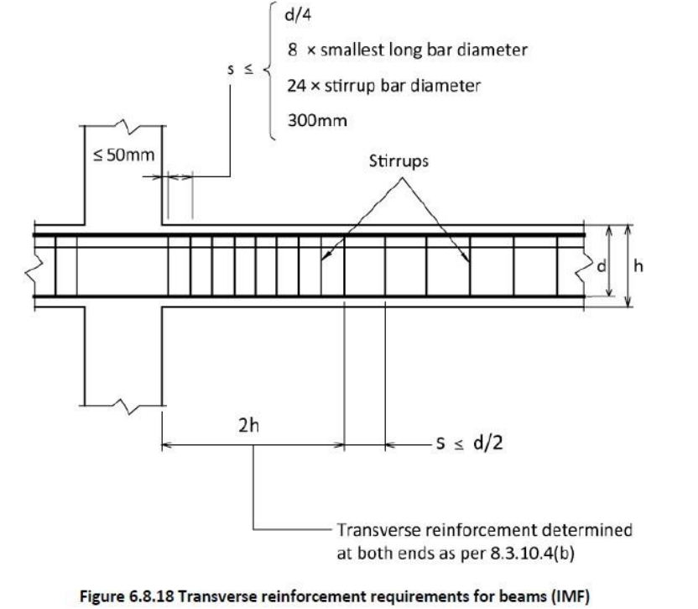
BEAM DESIGN
STEP #1
STEP #2
Longitudinal Reinforcement Calculation:
Main Bar Calculation at Middle, Left Corner, Right Corner from ETABS Data
Temperature and Shrinkage Reinforcement Calculation
Transverse Reinforcement Calculation :
Shear Reinforcement Value
from ETABS
Provided Tie Bar Spacing According to IMRF
Group 2
Reconstruction of Green Road Staff Quarter
30

Slide 31
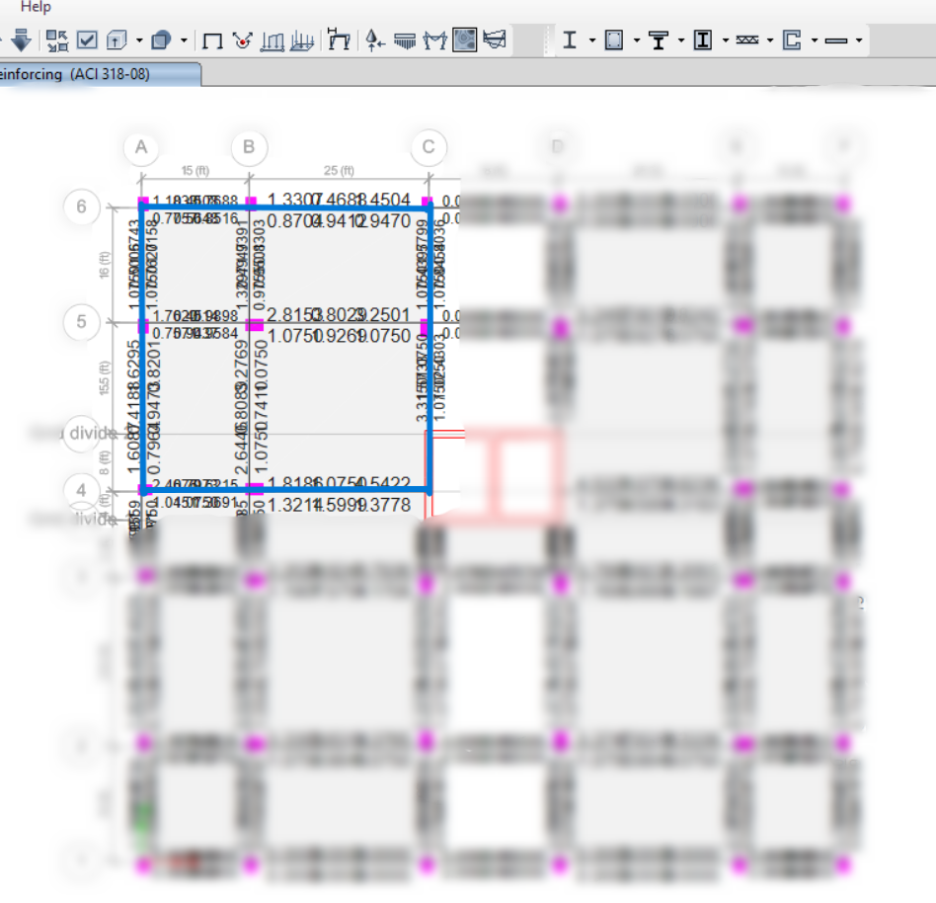
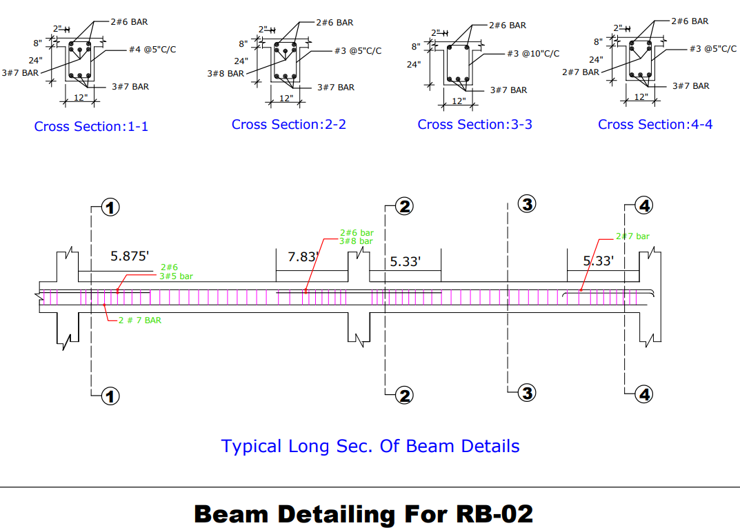
BEAM DESIGN
Beam Size – 15’’ x 24’’
3rd Floor
ETABS :
Stiffness Modifier : 0.35 and 0.0001
Group 2
Reconstruction of Green Road Staff Quarter
31

Slide 32
COLUMN DESIGN
STEP #1
STEP #2
STEP #3
STEP #4
Longitudinal Reinforcement:
Minimum Steel for Temperature and Shrinkage
Required Steel from ETABS Data
Compared and Provided Necessary Rebar
Tie Reinforcement:
16 * Dia of main bar
48 * Dia of Tie Bar
Least Dimension of Column
IMRF Requirements for L0:
Larger of C1 and C2
Clear Span / 6
18”
IMRF Requirements for Ties :
8 x Smallest Longitudinal Bar Diameter
24 x Tie Bar Diameter
0.5 x Smaller of C1 or C2
Group 2
Reconstruction of Green Road Staff Quarter
32

Slide 33

COLUMN DESIGN
EXTERIOR COLUMNS
INTERIOR COLUMNS
C1
C2, C3
18’’ x 24’’
20’’ x 30’’
C1
C2
C3
Base – 2F
3F – 10F
11F – 12F
Base – 2F
3F – 10F
11F – 12F
Base – 5F
6F – 10F
11F – 12F
Group 2
Reconstruction of Green Road Staff Quarter
33

Slide 34
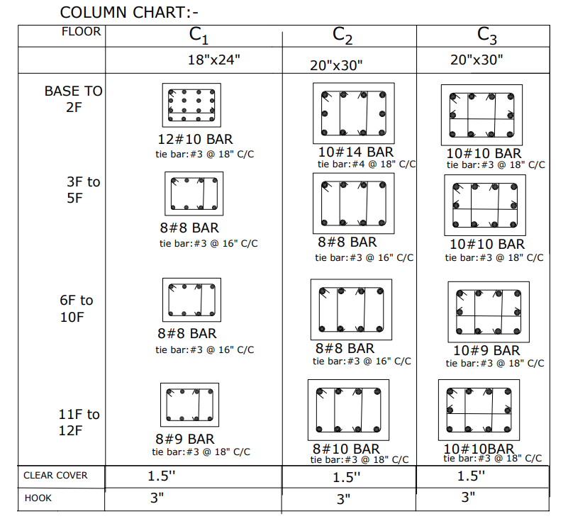
COLUMN DESIGN
CROSS SECTIONS OF C1,C2,C3 COLUMNS
10
5
Group 2
Reconstruction of Green Road Staff Quarter
34

Slide 35
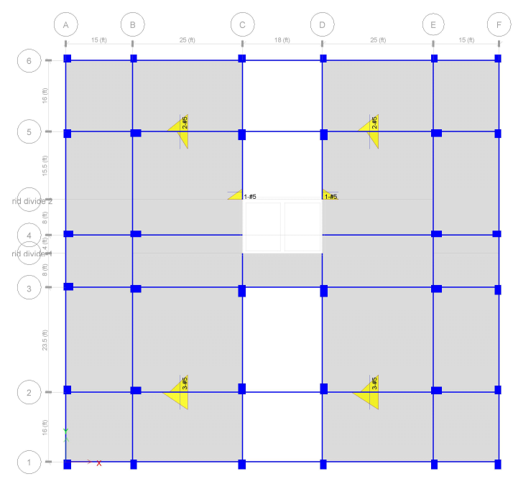
SLAB DESIGN
STEP #1
STEP #2
Minimum Reinforcement Calculation:
Required Reinforcement: 0.15 in²/ft
Spacing 10”
Extra Reinforcement from ETABS
Group 2
Reconstruction of Green Road Staff Quarter
35

Slide 36
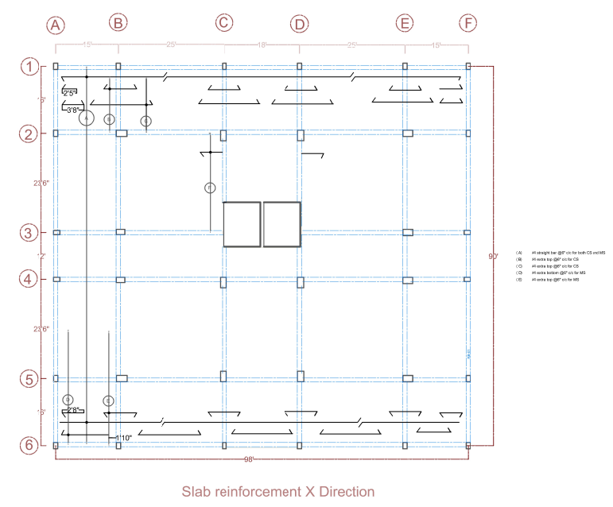
SLAB DESIGN
Slab (X-direction)
#4 straight bar @10” c/c for both CS and MS
#4 extra top @10” c/c for CS
#4 extra top @10” c/c for CS
#4 extra bottom @10” c/c for MS
#4 extra bottom @10” c/c for MS
Slab Reinforcement X Direction
Group 2
Reconstruction of Green Road Staff Quarter
36

Slide 37
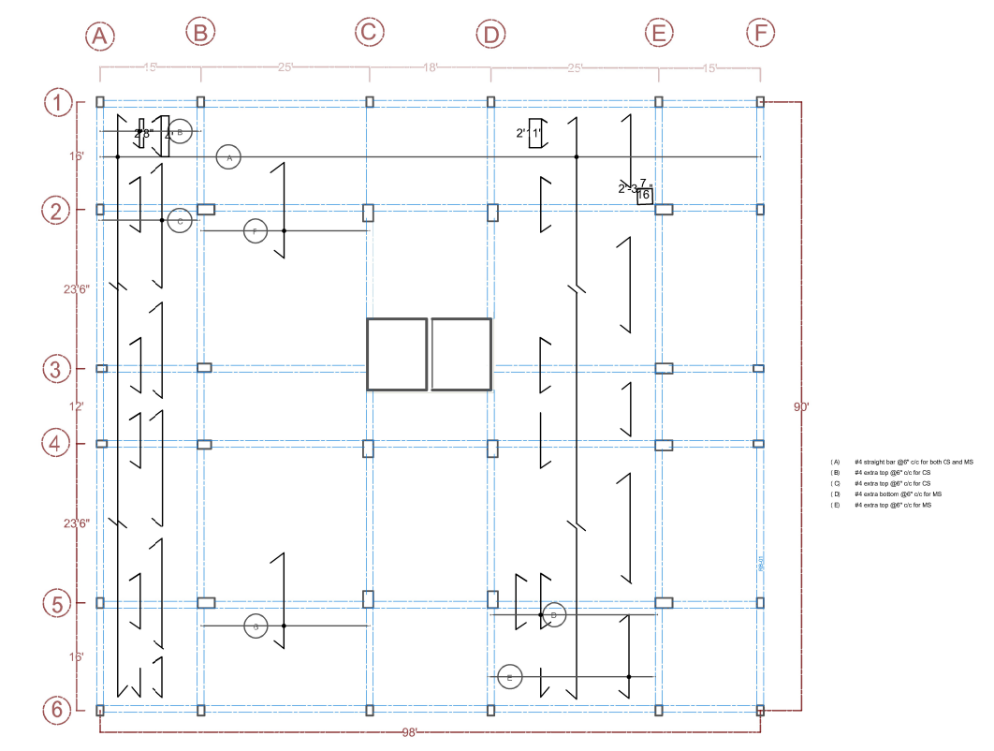
SLAB DESIGN
Slab (Y-direction)
#4 straight bar @10” c/c for both CS and MS
#4 extra top @10” c/c for CS
#4 extra top @10” c/c for CS
#4 extra bottom @10” c/c for MS
#4 extra bottom @10” c/c for MS
Slab Reinforcement Y Direction
Group 2
Reconstruction of Green Road Staff Quarter
37

Slide 38
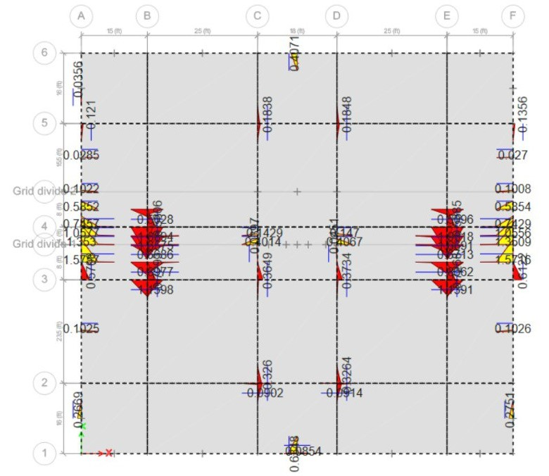
MAT FOUNDATION
STEP #1
STEP #2
Minimum Reinforcement Calculation:
Required Reinforcement: 0.89 in²/ft
Using #8@8”C/C
Extra Reinforcement from ETABS:
Stiffness Modifier: 0.25
Group 2
Reconstruction of Green Road Staff Quarter
38

Slide 39
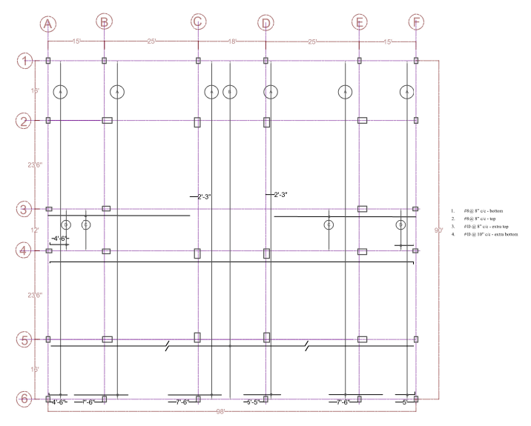
MAT FOUNDATION
X- direction:
#8@8”c/c - bottom
#8@8”c/c - top
#10@8”c/c - extra top
#10@10”c/c - extra bottom
Mat Foundation Reinforcement X Direction
Group 2
Reconstruction of Green Road Staff Quarter
39

Slide 40
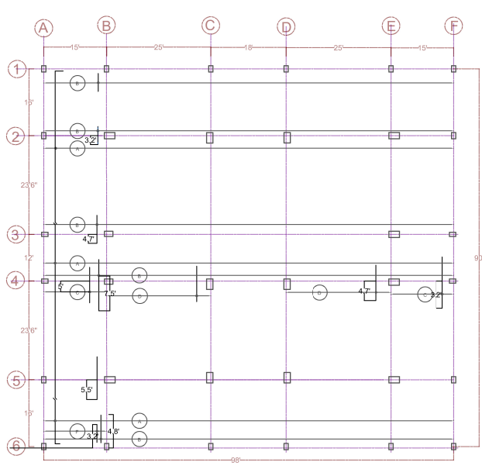
MAT FOUNDATION
Y- direction:
#8@8”c/c - bottom
#8@8”c/c - top
#7@12”c/c - extra top
#7@10”c/c - extra bottom
Mat Foundation Reinforcement Y Direction
Group 2
Reconstruction of Green Road Staff Quarter
40

Slide 41


WATER DEMAND CALCULATION
Peak Factor:
Domestic = 2.5
Mosque = 4
Community Center = 4
Domestic =180 lpcd
Mosque=75 lpcd
Water Demand As per BNBC 2020
Time Factor:
Domestic= 24/24 = 1
Mosque = 24/24 = 1
Community Center = 24/(2X6) = 2
Community Center=
90 lpcd
Group 2
Reconstruction of Green Road Staff Quarter
41

Slide 42
WATER DEMAND CALCULATION
Facility Type | Building Size (sft) | Water consumption BNBC 2020 (lpcd) | Water Demand (Mlpd)
Domestic | 1500 | 180 | 0.742
 | 1200 | 120 | 0.424
 | 1000 | 120 | 0.354
 | 800 | 80 | 0.236
Mosque | 3000 | 75 | 0.900
Community centre | 1000 | 90 | 0.720
Fire Hydrant | - | - | 0.291
Fire fighting | - | - | 0.540
Total Demand (Mlpd) |  |  | 4.206
Group 2
Reconstruction of Green Road Staff Quarter
42

Slide 43
WATER RESERVOIR
Type | Quantity | Dimension | Capacity
Under Ground Water Reservoir (Daily Use) | 2 | 22’x15’x10’ | 6710 cft
Under Ground Water Reservoir (Firefighting) | 1 | 15’x8’x10’ | 1100 cft
Over Head Water Tank | 2 | 15’x12’x10’ | 3500 cft
Septic Tank | 2 | 34’x11.2’x4.3’ | Sludge storage zone 0.19 m Sludge digestion zone 0.143 m Scum storage zone 0.076 m Sedimentation zone 0.599 m
Group 2
Reconstruction of Green Road Staff Quarter
43

Slide 44
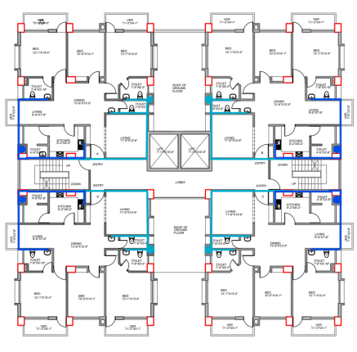
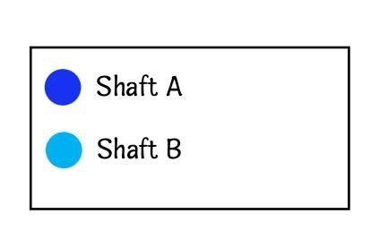
PLUMBING
PLUMBING
BRANCH LAYOUT
fIgURE: branch layouT
Group 2
Reconstruction of Green Road Staff Quarter
44

Slide 45
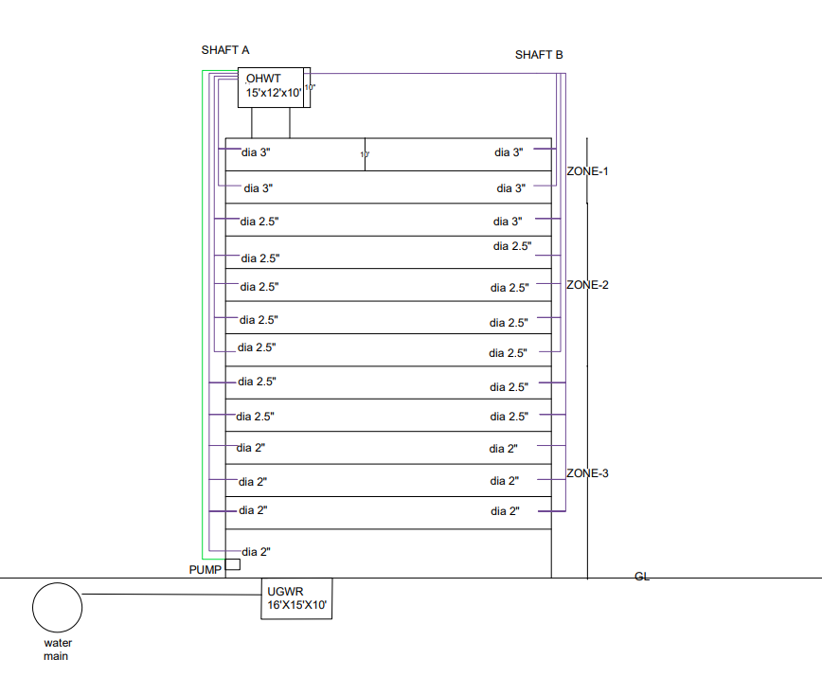
WATER SUPPLY ELEVATION
fIgURE : WATER SUPPLY ELEVATION OF BUILDING
Group 2
Reconstruction of Green Road Staff Quarter
45

Slide 46
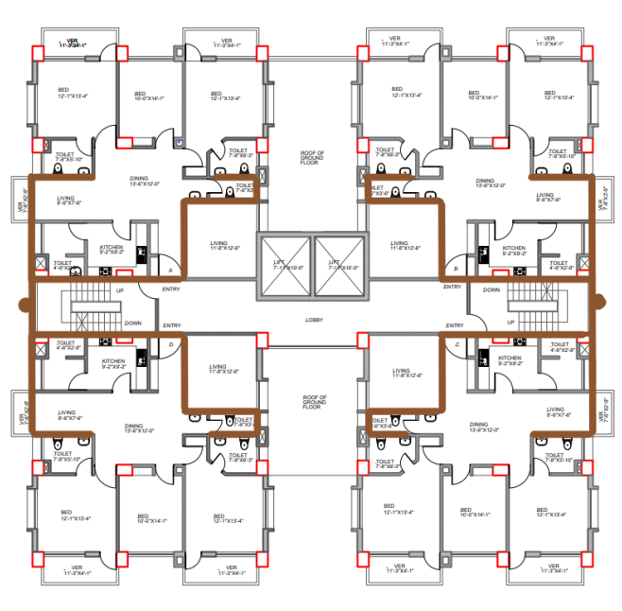
Soil branch
DRAINAGE
soil branch
Group 2
Reconstruction of Green Road Staff Quarter
46

Slide 47
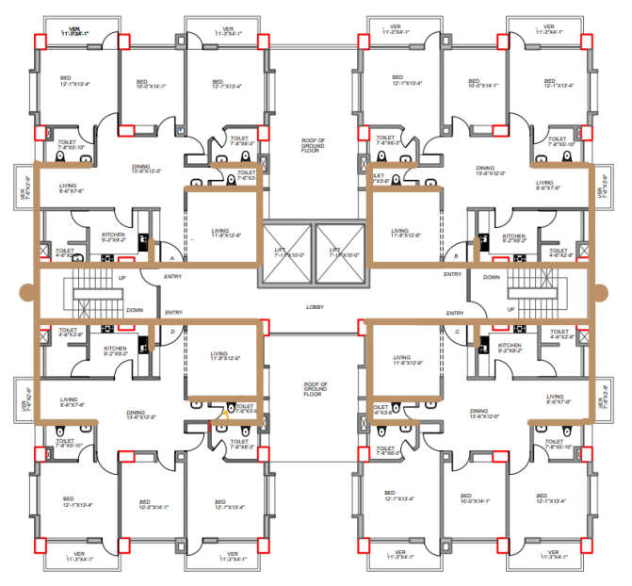
Waste branch
DRAINAGE
waste branch
WASTE branch
Group 2
Reconstruction of Green Road Staff Quarter
47

Slide 48
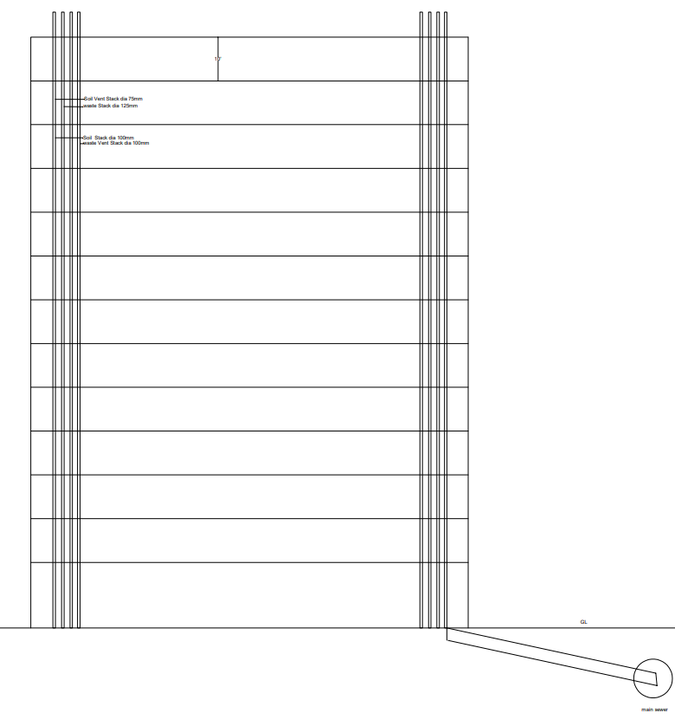
Vertical pipes
6.5’
12F
10’
Soil Vent Stack dia 75mm
Waste Stack dia 125mm
Soil Stack dia 100mm
Waste Vent Stack dia 100mm
VERTICAL PIPES
GL
Main Sewer
Group 2
Reconstruction of Green Road Staff Quarter
48

Slide 49
FINANCIAL AND ECONOMIC ANALYSIS
PROJECT LIFETIME
(50 YEARS)
FIRR
8.2%
ASSOCIATED COST
AND BENEFIT
EIRR
14%
COST ANALYSIS
INDICATOR
DR<IRR BCR>1
Group 2
Reconstruction of Green Road Staff Quarter
49

Slide 50
FINANCIAL AND ECONOMIC ANALYSIS
DR=12%
BCR=0.60
BCR=1.20
Financial Analysis
Economic Analysis
NOT FINANCIALLY
VIABLE
ECONOMICALLY
VIABLE
Group 2
Reconstruction of Green Road Staff Quarter
50

Slide 51
SENSITIVITY ANALYSIS
VARIABLES CONSIDERED
CASES CONSIDERED
01
CASH INFLOW
01
EXPECTED CASE
BASE CASE
PESSIMISTIC CASE
02
CASH OUTFLOW
02
COST BENEFIT
OPTIMISTIC CASE
03
DISCOUNT RATE
03
COST BENEFIT
Group 2
Reconstruction of Green Road Staff Quarter
51

Slide 52
SENSITIVITY ANALYSIS
EIRR VALUES
1
2
14%
ACTUAL COST AND BENEFIT
COST 10%
12.7%
12.6%
3
4
11.6%
BENEFIT 10%
COST 10%
+
BENEFIT 10%
COMPARATIVE ANALYSIS FOR PESSIMISTIC CASE
Group 2
Reconstruction of Green Road Staff Quarter
52

Slide 53
BILL OF QUANTITY
EARTHWORK EXCAVATION
COLUMN
SLAB
SUNSHADE
STAIR
LINTEL
8.6%
9.45%
6.23%
3.01%
4.93%
1.8%
1
2
3
4
5
6
7
8
9
10
11
12
0.27%
8.87%
20.89%
1.13%
1.63%
0.62%
MAT FOUNDATION
TIMBER (DOOR FRAME)
BEAM
FLOOR TILES
SHEAR WALL
BRICKWORK
COST PERCENTAGE ANALYSIS
Group 2
Reconstruction of Green Road Staff Quarter
53

Slide 54
BILL OF QUANTITY
TIMBER (DOOR SHUTTERING)
ALUMINIUM WINDOW FRAME
SKIRTING
PAINTING
OHWT
PLUMBING
1.35%
3.96%
5.02%
0.88%
0.49%
8.6%
13
14
15
16
17
18
19
20
21
22
23
24
0.46%
0.13%
1.05%
3.24%
0.49%
6.39%
GLASS WORK
RETAINING WALL
PLASTERING
UWGR
SEPTIC TANK
MISCELLANEOUS
COST PERCENTAGE ANALYSIS
Group 2
Reconstruction of Green Road Staff Quarter
54

Slide 55
BILL OF QUANTITY
3225 BDT
37 Crore
BDT
Cost Per
Building
Cost Per
Square Feet
Group 2
Reconstruction of Green Road Staff Quarter
55

Slide 56






COMPONENTS OF TOTAL PROJECT COST
Construction cost of 16 Buildings
Cost for Resettlement Concern
Cost of Green area and field Development
510 Crore BDT
Renovation Cost of Community space
Demolishing Cost
Parking Facility Development Cost
Group 2
Reconstruction of Green Road Staff Quarter
56

Slide 57
TENDER DOCUMENT
1
2
3
4
5
Instructions to Tenderers
General Conditions of Contract.
Particular Conditions of Contract
Tender & Contract Forms
Tender Data Sheet
9
8
7
6
Drawings
Particular Specifications
General Specifications
Bill of Quantities.
Group 2
Reconstruction of Green Road Staff Quarter
57

Slide 58
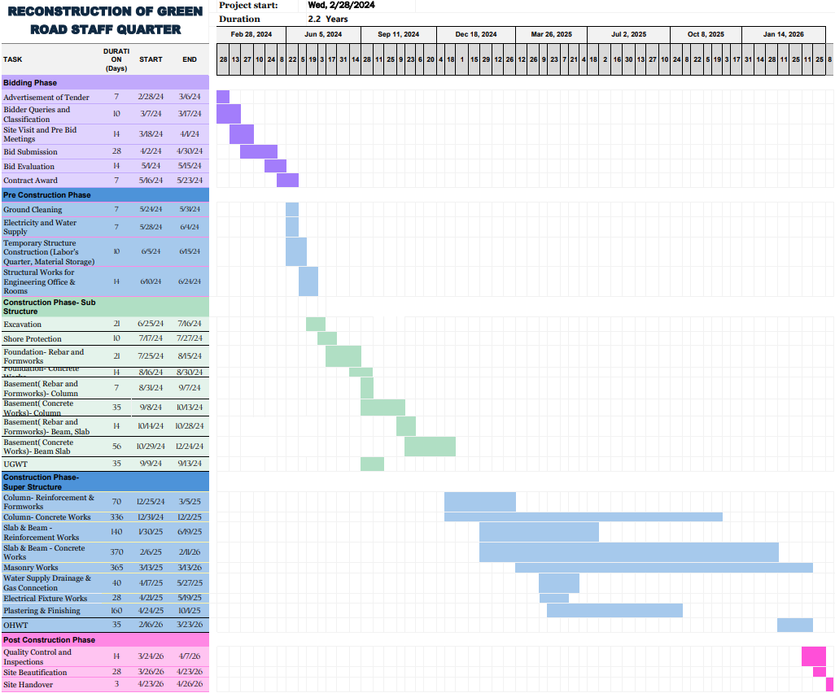
IMPLEMENTATION TIMELINE

Slide 59
RANGE OF COMPLEX ENGINEERING PROBLEM
K3
K4
THEORY BASED FORMULATION
SUPERSTRUCTURE AND SUBSTRUCTURE ANALYSIS
ANALYZE FOUNDATION TYPE
REACH CONCLUSIVE DECISION
P1
K5
DESIGN OF FLOOR PLAN
DESIGN OF PLUMBING SYSTEM
DESIGN OF STRUCTURAL SYSTEM
DEPTH OF ENGINEERING KNOWLEDGE REQUIRED
Group 2
Reconstruction of Green Road Staff Quarter
59

Slide 60
RANGE OF COMPLEX ENGINEERING PROBLEM
DEPTH OF ANALYSIS REQUIRED
FAMILIARITY OF ISSUES
EXTENT OF CODES
P3
P4
P5
MASTER PLAN PREPARE
ABSTRACT THINKING
DEMOLISHING BUILDINGS
ENVIRONMENTAL IMPACT
BNBC 2020
EURO CODE
RESETTLEMENT CONCERN
Group 2
Reconstruction of Green Road Staff Quarter
60

Slide 61
Thanks for Listening with great patience

